Slide 1
THE MODERN VIEW OF EVOLUTION

Slide 2
I. Populations
a) Variation (which arises from mutations of DNA molecules to produce new alleles), is a primary mechanism for natural selection.
A population is a group of individuals living in the same geographical area and sharing a common gene pool.
The gene pool is the sum of all genetic information carried by the members of a population.
All genetic variation in a population is generated by mutation which are any heritable change in DNA.
Whether a mutation is good, neutral, or harmful depends on how it affects survival and reproductive success.

Slide 3
II. Population Genetics
a) A population is a group of potentially interbreeding organisms of the same species occupying a certain area.
b) The variation that exists among the members of a population acts as the raw material for natural selection.
c) The source of variation within gene pools results from several variables including gene-level and the chromosome-level mutations, recombination by sexual reproduction and crossing over.
Mutations occur at random, and can be beneficial, neutral, or harmful depending upon the nature of the mutation as it corresponds to the environment.

Slide 4
d) The entire genotype is subject to natural selection since new combinations of alleles may have improve the reproductive success of the organism.
e) For polygenic traits, the most favorable combination may occur when the right alleles group by recombination.
The variations created are preserved and passed on from one generation to the next if they increase the fitness of the individuals within the population.
Neither dominance nor sexual reproduction will change allele frequencies.

Slide 5
III. The Hardy-Weinberg Law
a) This law states an equilibrium of allele frequencies in a gene pool remains in effect in each succeeding generation of a sexually reproducing population if five conditions are met.
b) Conditions of the Hardy-Weinberg Law
1. No mutation: no allelic changes occur.
2. No gene flow: migration of alleles into or out of the population does not occur.
3. Random mating: individuals pair by chance and not according to their genotypes or phenotypes.
4. No genetic drift: the population is large so changes in allele frequencies due to chance are insignificant.
5. No selection: no selective force favors one genotype over another.

Slide 6
c) These conditions of the Hardy-Weinberg law are rarely met, so allele frequencies in the gene pool of a population do change from one generation to the next, resulting in evolution.
We can now consider that any change of allele frequencies in a gene pool indicates that evolution has occurred.
The Hardy-Weinberg law proposes those factors that violate the conditions listed cause evolution.
Microevolution is the accumulation of small changes in a gene pool over a relatively short period.

Slide 7
Hardy-Weinberg Law
p2 + 2pq + q2 =1
Equation
p = frequency of the dominant allele
q = frequency of the recessive allele
p + q = 1 – This simple equation indicates the sum of a population’s dominant and recessive alleles is equal to the total gene sum.
p² - indicates the frequency of individuals with the pure dominant condition for a given set of alleles.
2pq - indicates the frequency of individuals with the hybrid condition for a given set of alleles.
q² ⁻ indicates the frequency of individuals with the recessive condition for a given set of alleles.

Slide 8
Hardy-Weinberg Law: Ex#1
In a population of individuals that is in Hardy-Weinberg Equilibrium, 9% of the individuals show the recessive trait.
a) Find the frequencies of the dominant and recessive alleles.
b) Find the percentages of pure dominant and hybrid individuals.

Slide 9
IV. The Causes of Microevolution
KEY IDEA:
Gene flow moves alleles among populations (via interbreeding and migration of breeding individuals).
Gene flow increases variation within a population by introducing new alleles produced in another population.
Continued gene flow tends to decrease the diversity among populations, causing gene pools to become similar.
Reduction or restriction of gene flow between populations is essential for the development of new species.

Slide 10
a) Genetic drift causes the frequency of alleles to change from generation to generation as a result of chance alone in a small gene pool.
Random mating involves individuals pairing by chance, not according to their genotypes or phenotypes which increases genetic variation.
Nonrandom mating involves individuals inbreeding and assortative mating which polarizes the population genetically.
1. Genetic drift results when a small fraction of organisms are separated from the larger population. The small population that diverges does not represent a true depiction of the original population’s gene pool.
This can occur in large or small populations.
Genetic drift causes gene pools of two isolated populations to become dissimilar as some alleles are lost and other are fixed.

Slide 11
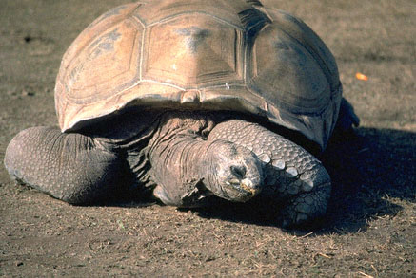
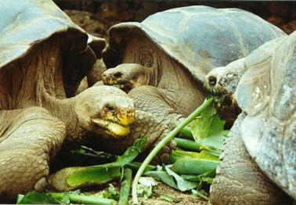
2. The Founder effect is a case of genetic drift in which rare alleles, or combinations of alleles, occur in higher frequency in a population isolated from the general population.
Ex: Darwin's finches or tortoises that correlated with different vegetation and environmental conditions on that island. on the Galápagos
Galapagos tortoises, note the difference in the height of the shell between the top and bottom images. Top image from Lycos, photo by Bill Everit; bottom image from http://home.capp.ch/marcel/Gal_Turt.htm

Slide 12
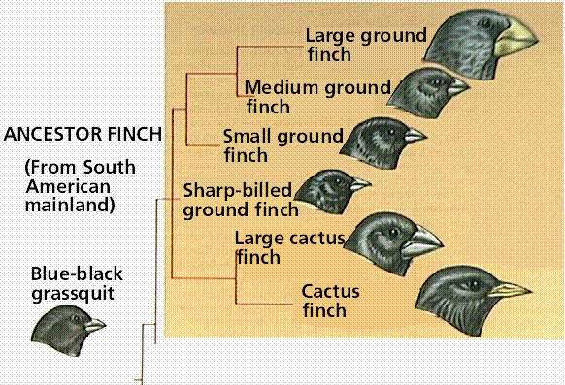
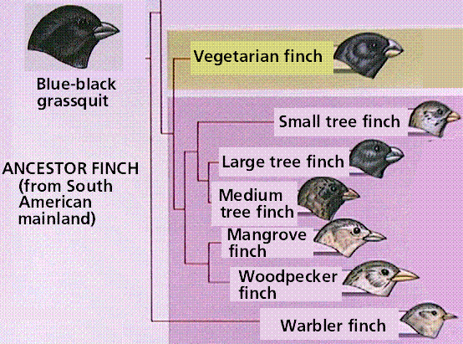
Divergence of the Galapagos finches from ancestral colonizers from the South American mainland.
Images from Purves et al., Life: The Science of Biology, 4th Edition, by Sinauer Associates (www.sinauer.com) and WH Freeman (www.whfreeman.com), used with permission.

Slide 13
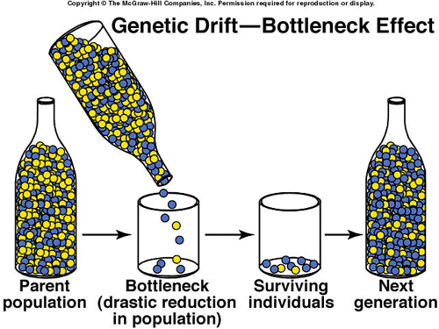
3. Bottleneck effect is genetic drift in which a severe reduction in population size results from natural disaster, predation, disease, or habitat reduction.
The survivors representing only a small portion of the original gene pool.
The end result is that a portion of its original genetic diversity remains lost.
This feature, termed a bottleneck, is a problem with many endangered species.
The bottleneck effect prevents most genotypes from participating in production of next generation.

Slide 14
b) Natural Selection: A Modern View
1. Not all members of a population necessarily have an equal chance of surviving and reproducing (due to competition for resources and mates).
2. The better adapted individuals are more "fit" and tend to survive and reproduce, passing on their adaptations to the next generation in greater frequency than those adaptations of the less "fit" members of the population.
3. Fitness is a measure of an individuals ability to survive and reproduce.
4. Natural selection is the process of differential survival and reproduction that inevitably leads to changes in allele frequencies over time.
5. There are three patterns, or types, of natural selection: Stabilizing Selection, Directional Selection, and Disruptive Selection.

Slide 15
c) Modes of Selection
1. Stabilizing selection favors the intermediate phenotype out of a range of phenotypes.
The extremes in variation are selected against.
EX: Infants weighing significantly less or more than 7.5 pounds have higher rates of infant mortality. Selection works against both extremes.
2. Directional Selection favors one of the extreme phenotypes over the mean and the other extreme phenotype.
EX: Ancestral Giraffes, antibiotic resistant bacteria, peppered moths.

Slide 16
3. Disruptive Selection is a unique type of selection in which both of the extreme phenotypes are favored over the mean.
This occurs when a population occupies an area that provides different types of resources that can be used by the species.
EX: Galapagos Finches: Large seeds contain a large supply of nutrients but they are difficult to crack open. Small seeds contain a small supply of nutrients yet are easy to crack open. Large birds easily use the food from large seeds. Small birds use the food from small seeds. Medium birds cannot crack open the large seeds and expend too much energy accumulating enough nutrients from the small seeds.

Slide 17
